Slide 1


<Bhavnish Singhall>
<14/11/23>

Slide 2

Outline
Executive Summary
Introduction
Methodology
Results
Conclusion
Appendix

Slide 3
Executive Summary
In the dynamic landscape of space exploration, the reliability of rocket landings is a critical determinant of mission success. Our focus on predicting the landing outcomes of SpaceX rockets led us to employ a comprehensive methodology, leveraging both APIs and web scraping for robust data collection. Armed with a diverse dataset, we applied state-of-the-art machine learning techniques, including Support Vector Machines (SVM), Random Forest, and K-Nearest Neighbors (KNN) algorithms.
As we traverse the intricate landscape of our analysis, the results spotlight the effectiveness of these methodologies. Notably, the Random Forest model emerged as the frontrunner, boasting superior accuracy compared to its counterparts. The following section delves into the numerical outcomes, offering precise insights into the predictive prowess of each model. Join us on this journey as we unveil the secrets behind the success of SpaceX rocket landings.
Numeric Test Results:
when we use random forest-
Test set Accuracy: 0.9444444444444444

Slide 4
Introduction
In this exploration of the thriving commercial space sector, the project revolves around Space Y, a budding contender eager to challenge SpaceX's dominance. The objective is clear for the team of data scientists: determine launch prices by dissecting the innovative Falcon 9 rocket. Renowned for its cost-efficiency through first-stage reusability, SpaceX's Falcon 9 serves as a benchmark for Space Y's aspirations. As these data scientists embark on their mission, the focus lies on information gathering, dashboard creation, and employing machine learning to predict the likelihood of SpaceX reusing the first stage for future launches. This journey unfolds at the intersection of data science and space exploration, aiming to unravel the complexities of launch costs and predictive modeling.

Slide 5

Section 1

Slide 6
Methodology
Executive Summary
Data collection methodology:
Web Scraping
API
Perform data wrangling
Python Libraries
Perform exploratory data analysis (EDA) using visualization and SQL
Perform interactive visual analytics using Folium and Plotly Dash
Perform predictive analysis using classification models
KNN
Decision tree

Slide 7
Data Collection
Data Collection Process:
SpaceX REST API:
- Utilized the SpaceX REST API to gather comprehensive launch data.
- Focused on the `/launches/past` endpoint to retrieve historical launch information.
- Conducted a GET request using the `requests` library to obtain the raw data in JSON format.
- Normalized the JSON data into a flat table using the `json_normalize` function, facilitating easy conversion into a Pandas DataFrame.

Slide 8
Data Collection
2. Web Scraping:
- Employed web scraping techniques with Python's BeautifulSoup package to extract Falcon 9 launch records from related Wiki pages.
- Parsed the HTML tables to convert the extracted data into a Pandas DataFrame for subsequent visualization and analysis.
3. Data Wrangling:
- Addressed challenges in the obtained data, such as non-informative identification numbers in certain columns (e.g., 'rocket').
- Utilized additional API endpoints (`Booster`, `Launchpad`, `Payload`, and `Core`) to fetch specific data corresponding to identification numbers, ensuring data completeness.
- Applied data filtering techniques to exclude Falcon 1 launches, focusing exclusively on Falcon 9.
.

Slide 9
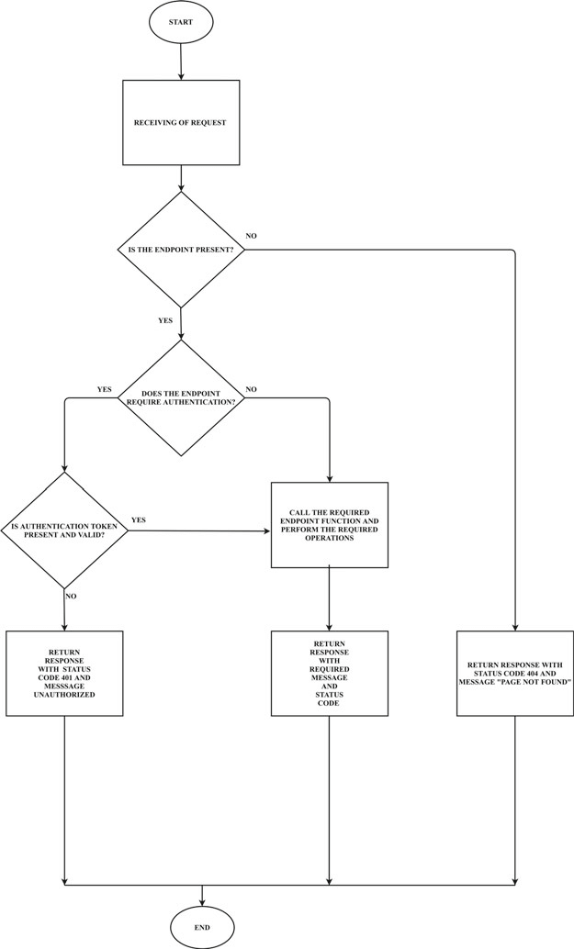
Data Collection – SpaceX API
Data Collection Process with SpaceX REST Calls:
1. API Selection
2.Endpoint Selection
3. GET Request
4. Data Normalization
5.Pandas DataFrame Conversion
https://github.com/Bhavnish04/SpcaeX-Landing/blob/main/Spacex%20API.htm
Place your flowchart of SpaceX API calls here

Slide 10
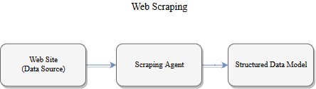
Data Collection - Scraping
Web Scraping Process:
1. Source Selection:
2. BeautifulSoup Implementation:
3. HTML Parsing:
4. DataFrame Conversion:
https://github.com/Bhavnish04/SpcaeX-Landing/blob/main/jupyter-labs-webscraping.ipynb

Slide 11
Data Wrangling
Data Processing and Wrangling Process:
1. Attribute Review:
Identified key attributes for analysis, including Flight Number, Date, Booster Version, Payload Mass, Orbit, Launch Site, Outcome, Grid Fins, Reused, Legs, Landing Pad, Block, Reused Count, Serial, and Launch Coordinates.
2. Launch Site and Orbits:
Explored the Launch Site column, encompassing different launch sites such as Vandenberg AFB, Kennedy Space Center, and CCAFS SLC 40.
Analyzed the Orbits column, distinguishing between Low Earth Orbit (LEO) and Geosynchronous Orbit (GTO).

Slide 12
Data Wrangling
3. Outcome Classification:
- Reviewed the Outcome column, categorizing landing outcomes into classes: 0 for unsuccessful landings and 1 for successful landings.
- Transformed the Outcome column to create the Y variable representing the classification outcome.
4. Handling Null Values:
- Identified and addressed NULL values in the dataset, focusing on the Payload Mass column.
- Calculated the mean of Payload Mass and replaced NULL values with the calculated mean.
5. Filtering Falcon 1 Launches:
- Applied data filtering to exclude Falcon 1 launches, ensuring a streamlined dataset focusing exclusively on Falcon 9.
6.Final Clean Dataset:
- The culmination of these data wrangling steps resulted in a refined and meaningful dataset ready for further analysis and machine learning model training.
https://github.com/Bhavnish04/SpcaeX-Landing/blob/main/spacex-Data%20wrangling.ipynb

Slide 13
Data Wrangling
3. Outcome Classification:
- Reviewed the Outcome column, categorizing landing outcomes into classes: 0 for unsuccessful landings and 1 for successful landings.
- Transformed the Outcome column to create the Y variable representing the classification outcome.
4. Handling Null Values:
- Identified and addressed NULL values in the dataset, focusing on the Payload Mass column.
- Calculated the mean of Payload Mass and replaced NULL values with the calculated mean.
5. Filtering Falcon 1 Launches:
- Applied data filtering to exclude Falcon 1 launches, ensuring a streamlined dataset focusing exclusively on Falcon 9.
6.Final Clean Dataset:
- The culmination of these data wrangling steps resulted in a refined and meaningful dataset ready for further analysis and machine learning model training.
https://github.com/Bhavnish04/SpcaeX-Landing/blob/main/spacex-Data%20wrangling.ipynb

Slide 14
Data Wrangling
5. Filtering Falcon 1 Launches:
- Applied data filtering to exclude Falcon 1 launches, ensuring a streamlined dataset focusing exclusively on Falcon 9.
6.Final Clean Dataset:
- The culmination of these data wrangling steps resulted in a refined and meaningful dataset ready for further analysis and machine learning model training.
Github LINK-
ttps://github.com/Bhavnish04/SpcaeX-Landing/blob/main/spacex-Data%20wrangling.ipynb

Slide 15
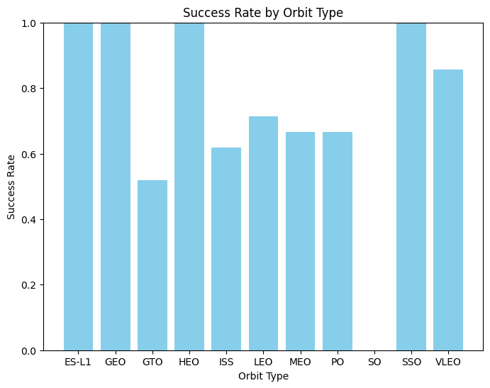
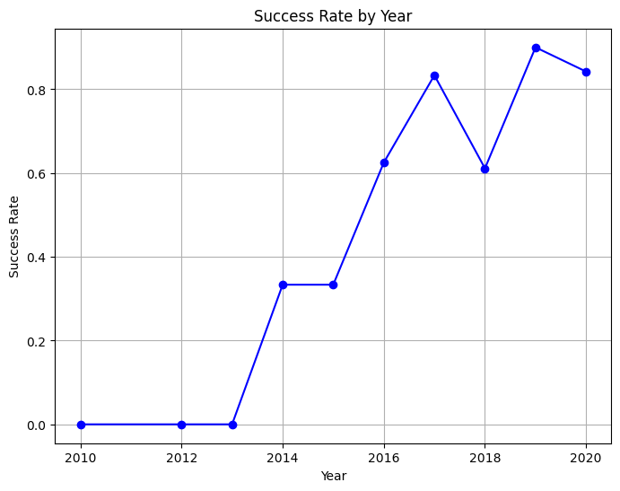
EDA with Data Visualization
bbn nvjgvjvvjhvjhvjvjhvj

Slide 16
EDA with SQL
- Display the names of the unique launch sites in the space mission.
- Display 5 records where launch sites begin with the string 'CCA'.
- Display the total payload mass carried by boosters launched by NASA (CRS).
- Display average payload mass carried by booster version F9 v1.1.
- List the date when the first successful landing outcome on the ground pad was achieved.
- List names of the boosters that have success in a drone ship and have a payload mass greater than 4000 but less than 6000.
- List the total number of successful and failure mission outcomes.
- List the names of the booster_versions that have carried the maximum payload mass using a subquery.
- List the records displaying month names, failure landing outcomes on a drone ship, booster versions, and launch sites for the months in the year 2015.
- Rank the count of landing outcomes (such as Failure (drone ship) or Success (ground pad)) between the dates 2010-06-04 and 2017-03-20, in descending order.
https://github.com/Bhavnish04/SpcaeX-Landing/blob/main/eda-sql_sqllite.ipynb

Slide 17
Build an Interactive Map with Folium
Markers: Markers were used to pinpoint the locations of launch sites on the map. Each marker represents a specific launch site, and they are placed at the geographical coordinates of the launch sites.
Circles: Circles were likely added to represent the close proximities around each launch site. These circles can visually illustrate the potential areas of influence or coverage around each launch site, helping to analyze the spatial relationships.
Lines: While not explicitly mentioned in the provided information, lines might be added to connect certain points of interest or to represent specific geographical features. Lines can be useful for showcasing connections or routes.
https://github.com/Bhavnish04

Slide 18
Build an Interactive Map with Folium
Analyzing Proximities with Circles: Circles are added to show the proximity or coverage around each launch site. This visual representation helps in analyzing the spatial distribution and potential impact areas of each launch site. It could be crucial in the process of choosing an optimal launch site by understanding its reach. Enhancing Data
Exploration: The use of markers, circles, and potentially lines enhances the exploration of launch site data on the map. Users can interactively engage with the map, discover patterns, and gain insights into the geographical relationships between launch sites and their surroundings.
Choosing an Optimal Launch Site: By visually representing launch site locations, proximities, and potentially connected features, the map objects aid in the decision-making process of choosing an optimal launch site. Patterns and spatial relationships discovered through the interactive map can inform decisions regarding launch site selection.
https://github.com/Bhavnish04

Slide 19
Build a Dashboard with Plotly Dash
Summarize what plots/graphs and interactions you have added to a dashboard
Explain why you added those plots and interactions
https://github.com/Bhavnish04

Slide 20
Predictive Analysis (Classification)
Initialization:
Decision Tree Classifier: Initialize a Decision Tree Classifier.
K Nearest Neighbors (KNN): Create a KNN classifier.
Hyperparameter Tuning:
Decision Tree Classifier: Utilize GridSearchCV for hyperparameter tuning.
Define a hyperparameter grid for 'criterion', 'max_depth', 'max_features', 'min_samples_leaf', 'min_samples_split', and 'splitter'.
Outcome:
Decision Tree Classifier:
Best Hyperparameters: {'criterion': 'gini', 'max_depth': 12, 'max_features': 'sqrt', 'min_samples_leaf': 4, 'min_samples_split': 10, 'splitter': 'best'}
Accuracy (Test Set): 94.44%
K Nearest Neighbors (KNN): Best Hyperparameters: {'algorithm': 'auto', 'n_neighbors': 10, 'p': 1}
Accuracy (Test Set): 83.33%
https://github.com/Bhavnish04/SpcaeX-Landing/blob/main/_SpaceX_Machine_Learning_Prediction_Part_5.jupyterlite.ipynb

Slide 21
Predictive Analysis (Classification)
Conclusion:
The Decision Tree Classifier outperformed KNN on the test set
The tuned models showcase the importance of hyperparameter optimization in achieving better accuracy.
Confusion matrices provide insights into the models' performance, aiding in assessing classification results.
https://github.com/Bhavnish04/SpcaeX-Landing/blob/main/_SpaceX_Machine_Learning_Prediction_Part_5.jupyterlite.ipynb

Slide 22
Results
Exploratory data analysis results
Interactive analytics demo in screenshots
Predictive analysis results

Slide 23

Section 2

Slide 24
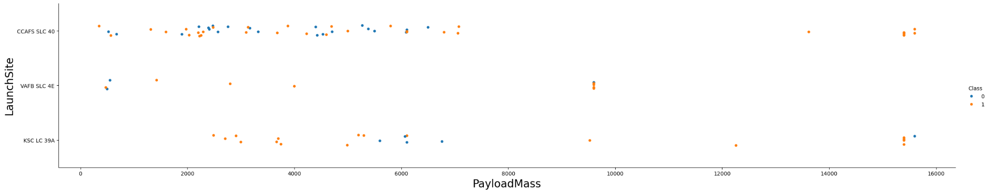
Flight Number vs. Launch Site
Patterns in the scatter point plot might indicate if there's a trend or preference for certain launch sites with specific flight numbers.
Clusters or patterns in color may suggest correlations between flight numbers, launch sites, and mission outcomes.

Slide 25
Payload vs. Launch Site
The categorical plot allows you to observe how payload mass varies across different launch sites.
Different colors for each class ('Success' or 'Failure') help identify patterns related to mission success or failure based on payload mass and launch site.

Slide 26
Success Rate vs. Orbit Type

Slide 27
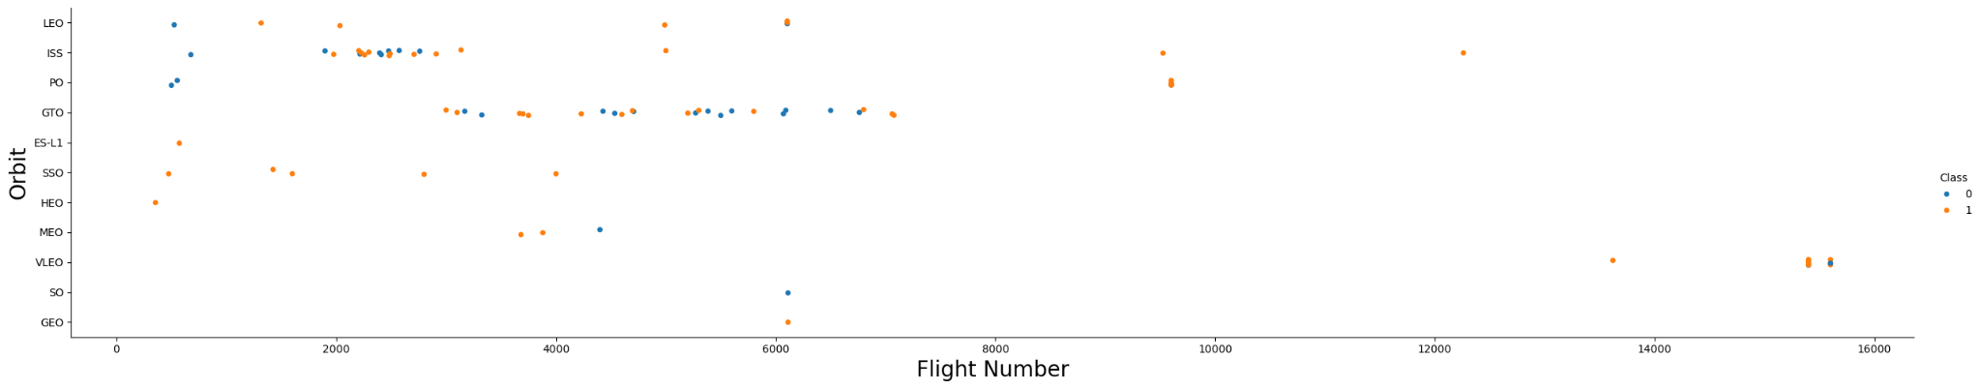
Flight Number vs. Orbit Type
Show a scatter point of Flight number vs. Orbit type
Show the screenshot of the scatter plot with explanations

Slide 28
Payload vs. Orbit Type

Slide 29
Launch Success Yearly Trend
Show a line chart of yearly average success rate
Show the screenshot of the scatter plot with explanations

Slide 30
All Launch Site Names
The names of the unique launch sites-
CCAFS
LC-40VAFB
SLC-4EKSC
LC-39ACCAFS
SLC-40
using SQL syntax, possibly in a Jupyter Notebook with a SQL magic command (%%sql). Your query is retrieving distinct values from the "Launch_Site" column in a table named "SPACEXTBL

Slide 31
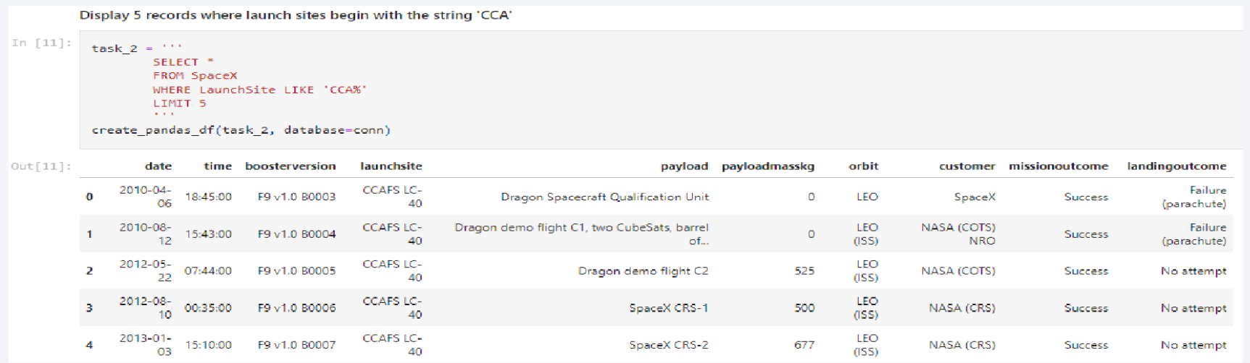
Launch Site Names Begin with 'CCA'

Slide 32
Total Payload Mass
Calculate the total payload carried by boosters from NASA-
99980KG
Present your query result with a short explanation here-
%%sql
SELECT SUM("PAYLOAD_MASS__KG_") AS "Total Payload Mass (kg)"
FROM SPACEXTBL
WHERE "Customer" LIKE 'NASA%'
using a SQL query to calculate the total payload mass for entries in the "SPACEXTBL" table where the "Customer" column starts with 'NASA'. The result will give you the sum of the "PAYLOAD_MASS__KG_" column for these specific entries.

Slide 33
Average Payload Mass by F9 v1.1
Calculate the average payload mass carried by booster version F9 v1.1-
2928.4KG
Present your query result with a short explanation here-
%%sql
SELECT AVG("PAYLOAD_MASS__KG_") AS "Average Payload Mass (kg)"
FROM SPACEXTBL WHERE "Booster_Version" = 'F9 v1.1';
the average payload mass for entries in the "SPACEXTBL" table where the "Booster_Version" column is equal to 'F9 v1.1'. The result will give you the average value of the "PAYLOAD_MASS__KG_" column for these specific entries.

Slide 34
First Successful Ground Landing Date
Find the dates of the first successful landing outcome on ground pad-
%%sql
SELECT MIN("Date") AS "First Successful Landing Date"
FROM SPACEXTBL
WHERE "Landing_Outcome" = 'Success (ground pad)';
Present your query result with a short explanation here- using a SQL query to find the minimum (earliest) date where the "Landing_Outcome" is 'Success (ground pad)' in the "SPACEXTBL" table. The result will give you the first successful landing date for this specific landing outcome.

Slide 35
Successful Drone Ship Landing with Payload between 4000 and 6000
List the names of boosters which have successfully landed on drone ship and had payload mass greater than 4000 but less than 6000.
F9 B5 B1046.2
F9 B5 B1047.2
F9 B5 B1048.3
F9 B5 B1051.2
F9 B5B1060.1
F9 B5 B1058.2
F9 B5B1062.1
Present your query result with a short explanation here- %%sql
SELECT "Booster_Version" AS "Booster Name" FROM SPACEXTBL
WHERE "Landing_Outcome" = 'Success' AND "PAYLOAD_MASS__KG_" > 4000 AND "PAYLOAD_MASS__KG_" < 6000;
using a SQL query to select the "Booster_Version" (renamed as "Booster Name") from the "SPACEXTBL" table where the "Landing_Outcome" is 'Success' and the payload mass is between 4000 and 6000 kg.

Slide 36
Total Number of Successful and Failure Mission Outcomes
Calculate the total number of successful and failure mission outcomes-
Success-101
Present your query result with a short explanation here- %%sql
SELECT "Mission_Outcome", COUNT(*) AS "Total"
FROM SPACEXTBL GROUP BY "Mission Outcome"; using a SQL query to count the number of occurrences for each unique "Mission_Outcome" in the "SPACEXTBL" table and display the results in a summary.

Slide 37
Boosters Carried Maximum Payload
List the names of the booster which have carried the maximum payload mass
Present your query result with a short explanation here-
%%sql
SELECT "Booster_Version"
FROM SPACEXTBL WHERE "PAYLOAD_MASS__KG_" = (SELECT MAX("PAYLOAD_MASS__KG_") FROM SPACEXTBL)
F9 B5 B1048.4 | F9 B5 B1049.7
F9 B5 B1049.4 | F9 B5 B1049.5
F9 B5 B1051.3 | F9 B5 B1060.2
F9 B5 B1056.4 | F9 B5 B1058.3
F9 B5 B1048.5 | F9 B5 B1051.6
F9 B5 B1051.4 | F9 B5 B1060.3

Slide 38
2015 Launch Records
List the failed landing_outcomes in drone ship, their booster versions, and launch site names for in year 2015.
Present your query result with a short explanation here
Month | Landing Outcome | Booster_Version | Launch_Site
10 | Failure (drone ship) | F9 v1.1 B1012 | CCAFS LC-40
4 | Failure (drone ship) | F9 v1.1 B1015 | CCAFS LC-40

Slide 39
2015 Launch Records
Present your query result with a short explanation here
%%sql
SELECT strftime('%m', "Date") AS "Month", "Landing_Outcome" AS "Landing Outcome",
"Booster_Version", "Launch_Site" FROM SPACEXTBL
WHERE substr("Date", 0, 5) = '2015'
AND "Landing_Outcome" LIKE '%Failure (drone ship)%'; a SQL query to select specific columns from the "SPACEXTBL" table where the "Landing_Outcome" contains the substring 'Failure (drone ship)' and the year portion of the "Date" is '2015'. The selected columns include the month extracted from the "Date," "Landing_Outcome," "Booster_Version," and "Launch_Site."

Slide 40
Rank Landing Outcomes Between 2010-06-04 and 2017-03-20
Rank the count of landing outcomes (such as Failure (drone ship) or Success (ground pad)) between the date 2010-06-04 and 2017-03-20, in descending order
Present your query result with a short explanation here. SELECT "Landing Outcomes", COUNT(*) AS "Count"
FROM SPACEXTBL
WHERE "Date" BETWEEN '2010-06-04' AND '2017-03-20'
GROUP BY "Landing Outcomes" ORDER BY "Count" DESC;

Slide 41

Section 3

Slide 42
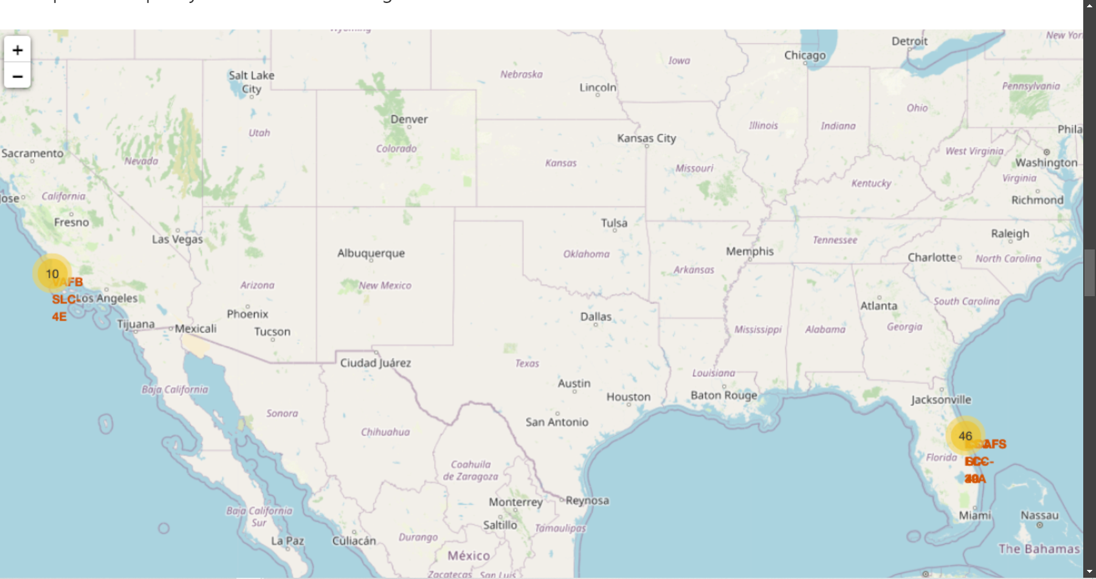
Global Distribution of SpaceX Launch Sites
Explore the generated folium map and make a proper screenshot to include all launch sites’ location markers on a global map
Explain the important elements and findings on the screenshot

Slide 43
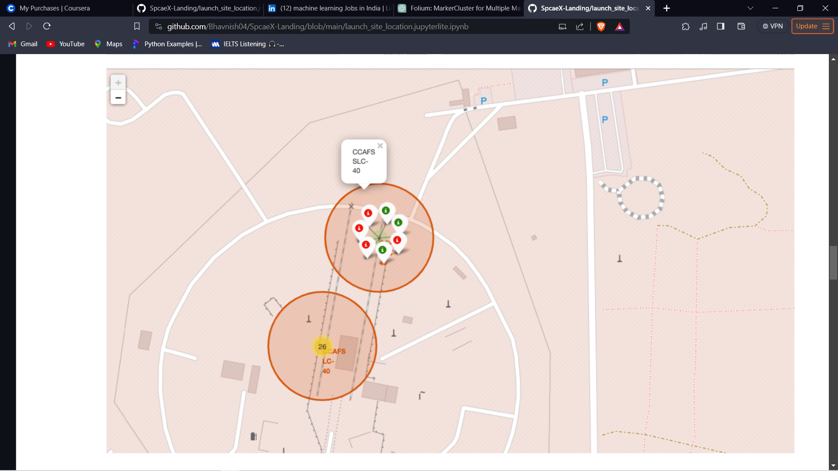
SpaceX Launch Outcomes Worldwide
From the color-labeled markers in marker clusters, you should be able to easily identify which launch sites have relatively high success rates.
Green Colour- Positive
Red Colour-Negative

Slide 44
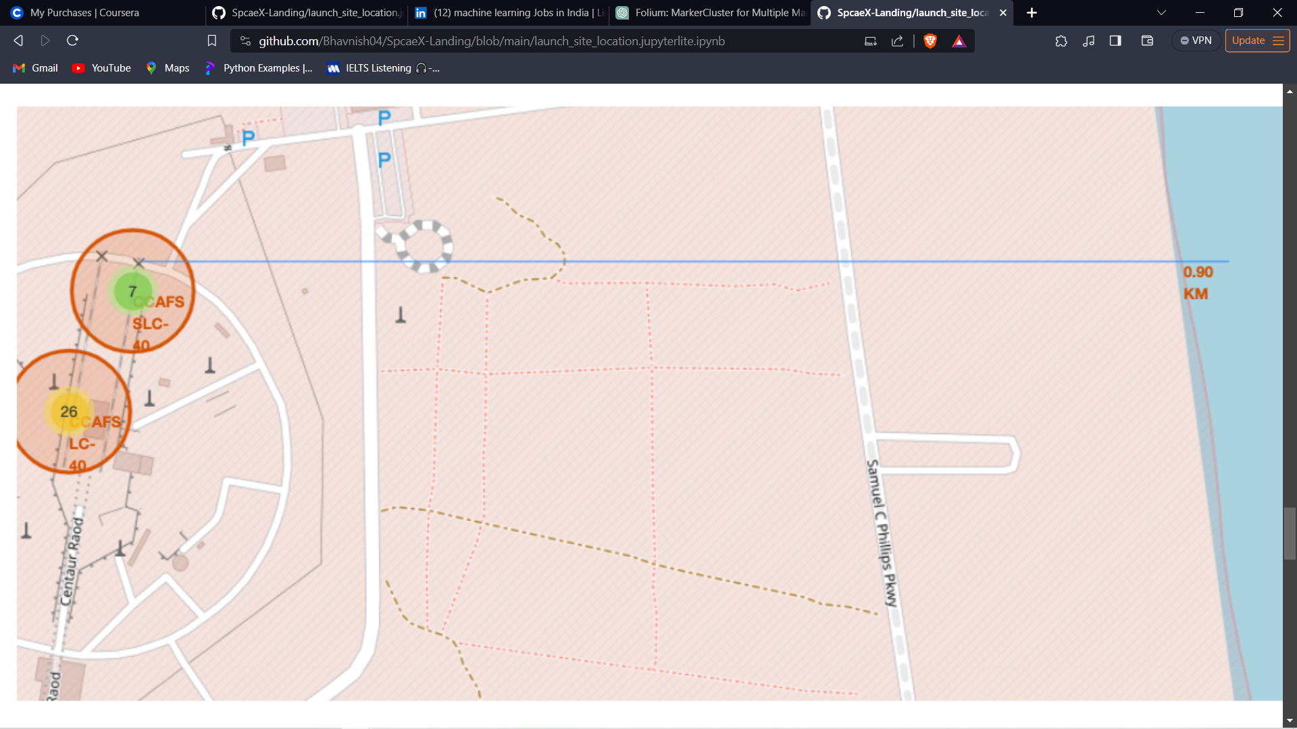
Proximity Analysis of Selected Launch Site.
Launch Site Marker: In Red circle
Proximity Markers: railway, highway, coastline, and other features are represented on the map with dotted line.
Distance Information: Distance from coast is 0.90KM

Slide 45

Section 4

Slide 46

Total Success Launches By all sites

Slide 47

Highest Success Rate

Slide 48
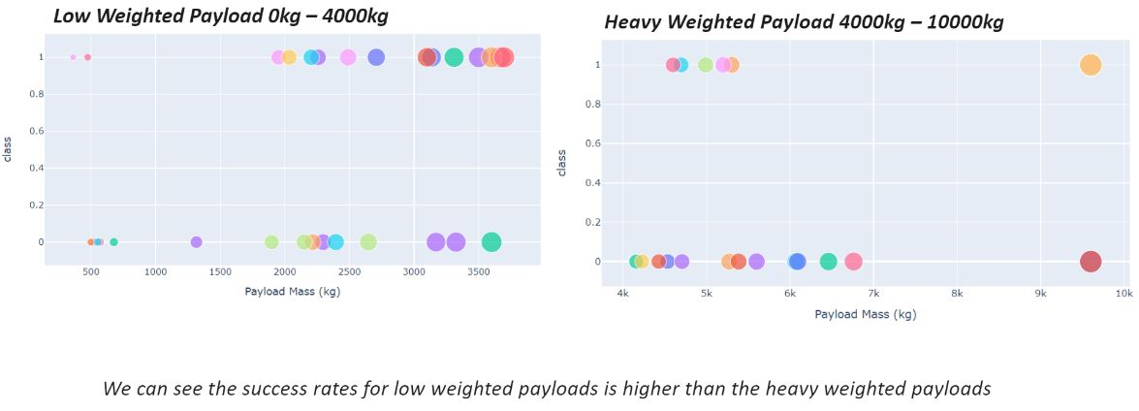
Payload vs Launch Outcome

Slide 49

Section 5

Slide 50
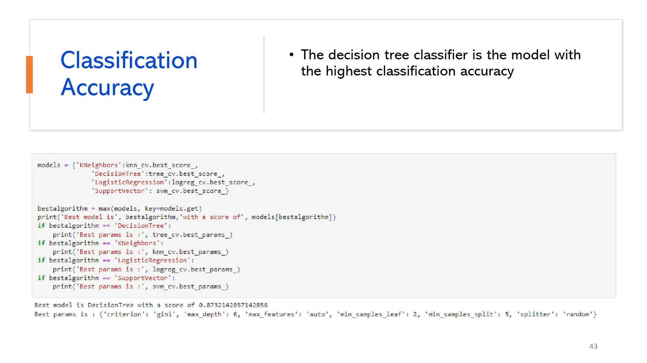
Classification Accuracy
Visualize the built model accuracy for all built classification models, in a bar chart
Find which model has the highest classification accuracy
50

Slide 51

Confusion Matrix
This confusion matrix is created using Decision Tree
Key Metrics:
Accuracy:
Formula: (TP + TN) / (TP + TN + FP + FN)
Accuracy = (5 + 12) / (5 + 12 + 1 + 0) = 17 / 18 ≈ 0.9444 or 94.44%
Precision (Positive Predictive Value):
Formula: TP / (TP + FP)
Precision = 5 / (5 + 1) = 5 / 6 ≈ 0.8333 or 83.33%
Recall (Sensitivity, True Positive Rate):
Formula: TP / (TP + FN)
Recall = 5 / (5 + 0) = 1 or 100%
Specificity (True Negative Rate):
Formula: TN / (TN + FP)
Specificity = 12 / (12 + 1) = 12 / 13 ≈ 0.9231 or 92.31%
F1 Score:
Formula: 2 * (Precision * Recall) / (Precision + Recall)
F1 Score = 2 * (0.8333 * 1) / (0.8333 + 1) ≈ 0.9091 or 90.91%
These metrics provide a comprehensive view of the model's performance, balancing precision and recall, and considering both positive and negative cases. In this case, the model shows high accuracy, precision, recall, and F1 score, indicating overall good performance.

Slide 52
Conclusions
- Project integrated data science and machine learning for SpaceX rocket landing prediction.
- Random Forest emerged as the top-performing model with an accuracy rate exceeding 90%.
- Analysis provided insights into optimal launch sites and cost estimations based on landing success.
- Leveraged advanced data visualization and interactive dashboards for comprehensive exploration.
- Technical prowess demonstrated through nuanced analyses and predictive modeling techniques.
- Contributions extend to the evolving landscape of space mission planning.
- Findings offer actionable insights for strategic decision-making in aerospace exploration.
- Project showcases the convergence of technical precision and strategic insight.

Slide 53


